Slide 1

RASD
- Vocabulary and data model
Gaia Resources
+61 8 9227 7309
Level 6, FLUX 191 St Georges Terrace, Perth
enquiries@gaiaresources.com.au

Slide 2
RASD - Vocabulary and data model
Current Scene

Slide 3
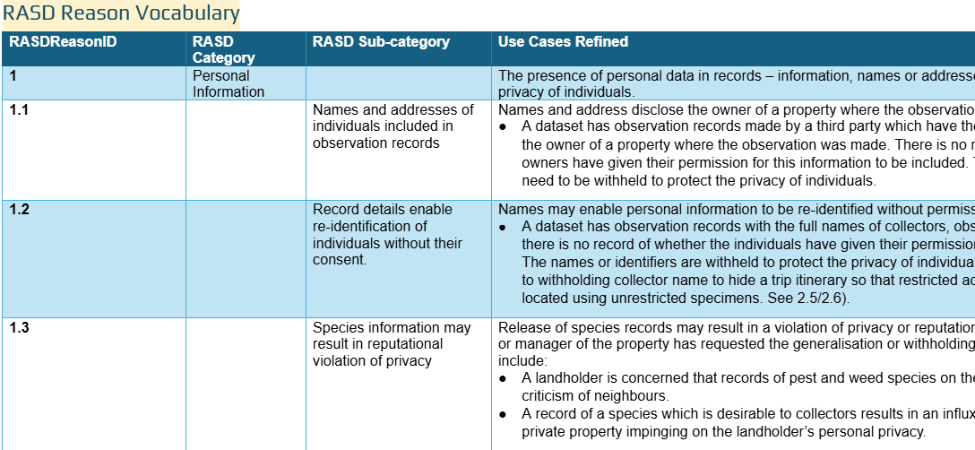
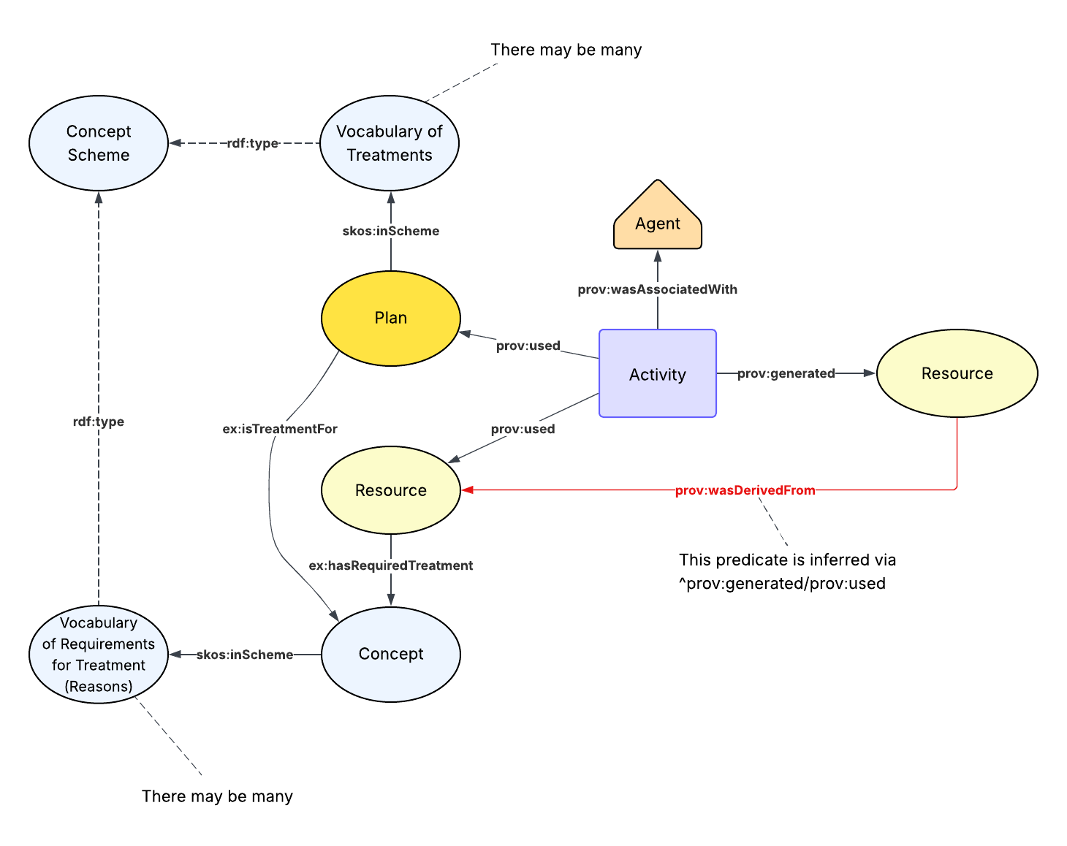
Where we are
Structured list of reasons for restrictions and data treatments
Conceptual model

Slide 4
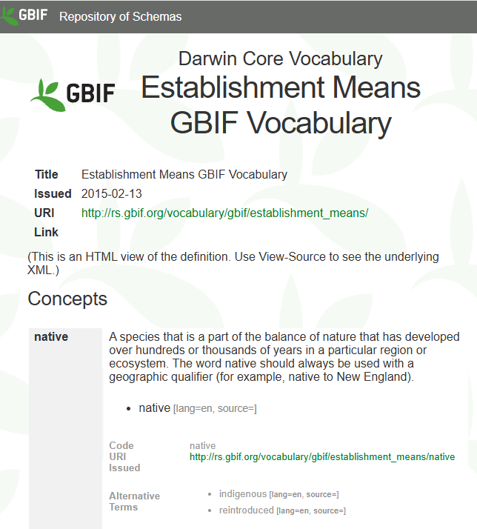
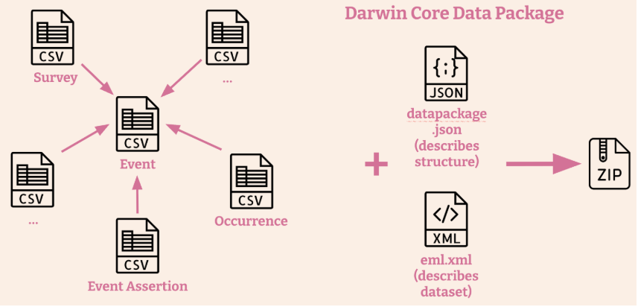
Where we are going…
https://rs.gbif.org/vocabulary/gbif/establishment_means.xml
Adjust the structure of the list into a FAIR vocabulary
Apply the conceptual model to data and to DwC/ DwC-DP
https://gbif.github.io/dwc-dp/#darwin-core-conceptual-model

Slide 5
RASD - Vocabulary and data model
Vocabulary exploration - structure

Slide 6
Restructure
Shortened sub-category titles to short phrase
Follow SKOS notation
FAIR data principles
Linked Data enabled

Slide 7
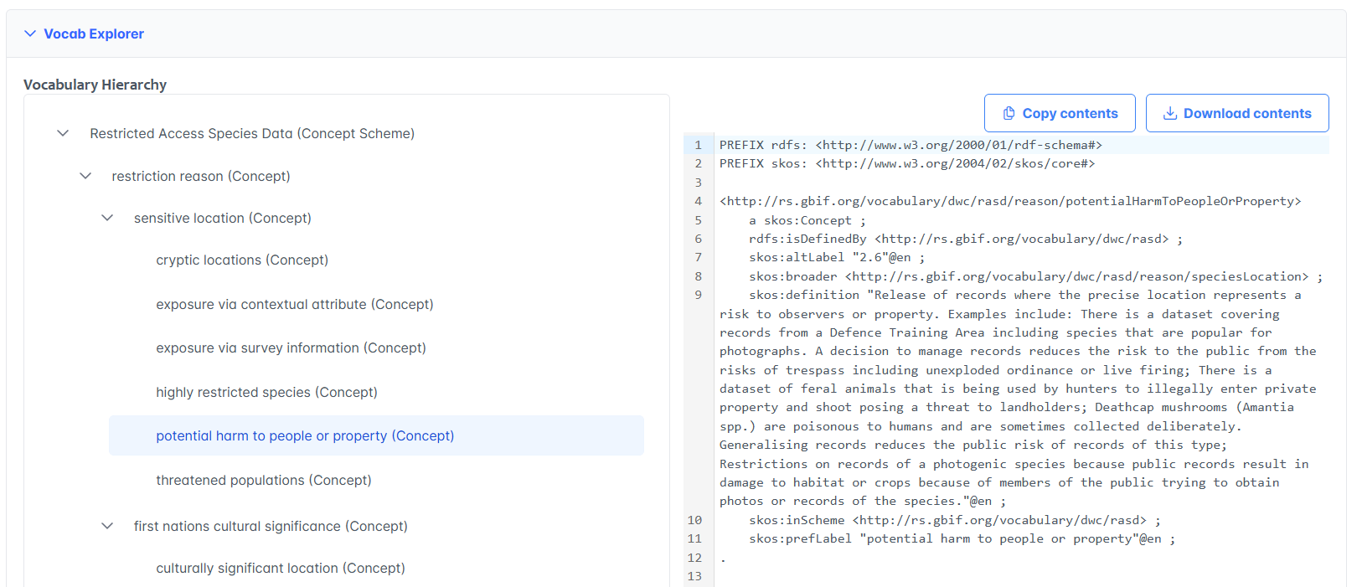
Category = concept

Slide 8
RASD - Vocabulary and data model
Vocabulary exploration - data model

Slide 9
Conceptual model
Relates original resource to treated resource via a treatment activity
The treatment came about due to a reason
The treatments and reasons have formalised vocabularies

Slide 10
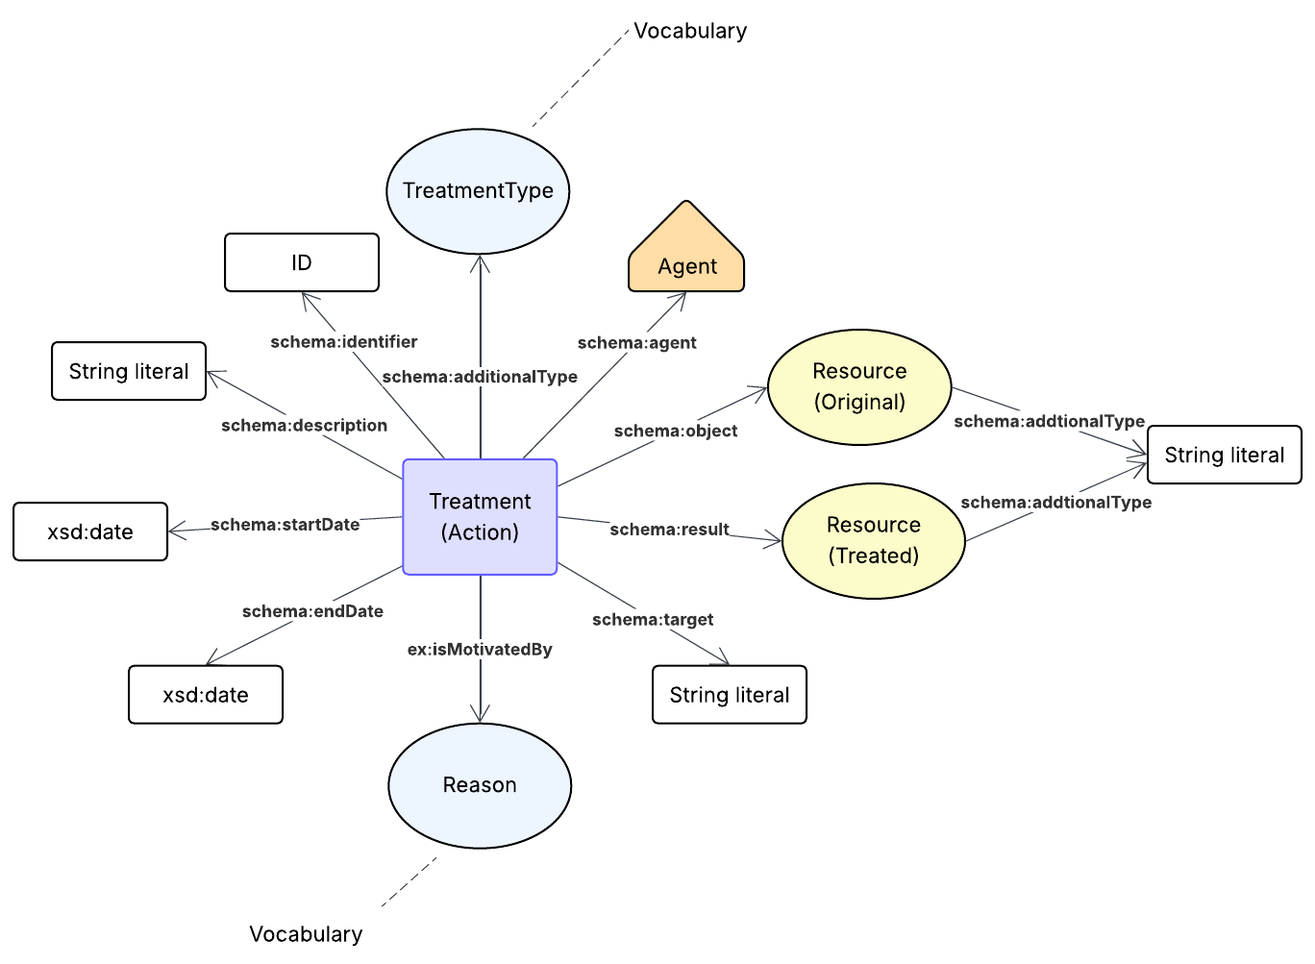
Treatment - focal point

Slide 11
Field | Example
treatmentID* | 550e8400-e29b-41d4-a716-446655440000
originalResource | s1234-occ1234
treatedResource* | s1234-occ1234t
resourceType* | dwc:Occurrence
treatmentType* | obfuscate coordinates
treatmentTarget | dwc:decimalLatitude, dwc:decimalLongitude
treatmentReason* | Potential harm to people or property
treatmentDescription | Coordinates obfuscated to bottom left corner of map grid square
treatmentStartDate | 2025-09-24
treatmentEndDate
treatmentOrganization | Department Of Environment
Treatment - focal point

Slide 12
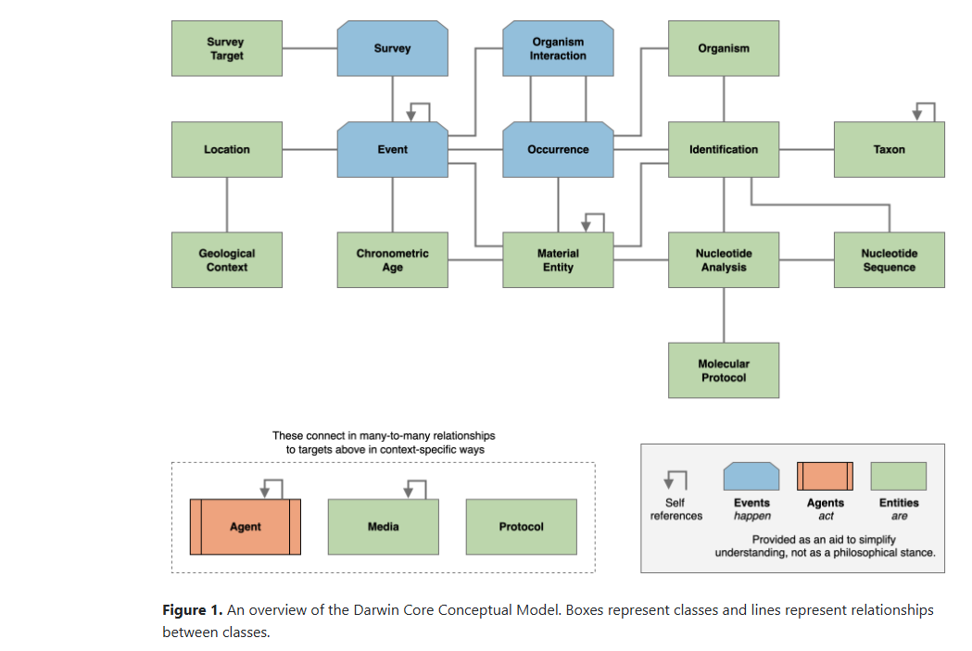
DwC-DP implementation
Treatment
https://gbif.github.io/dwc-dp/cm/

Slide 13
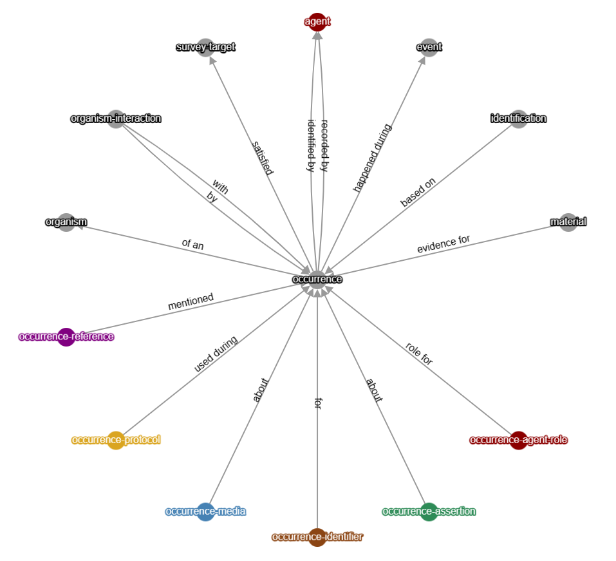
DwC-DP
Resource = Occurrence
applied to
treatment

Slide 14
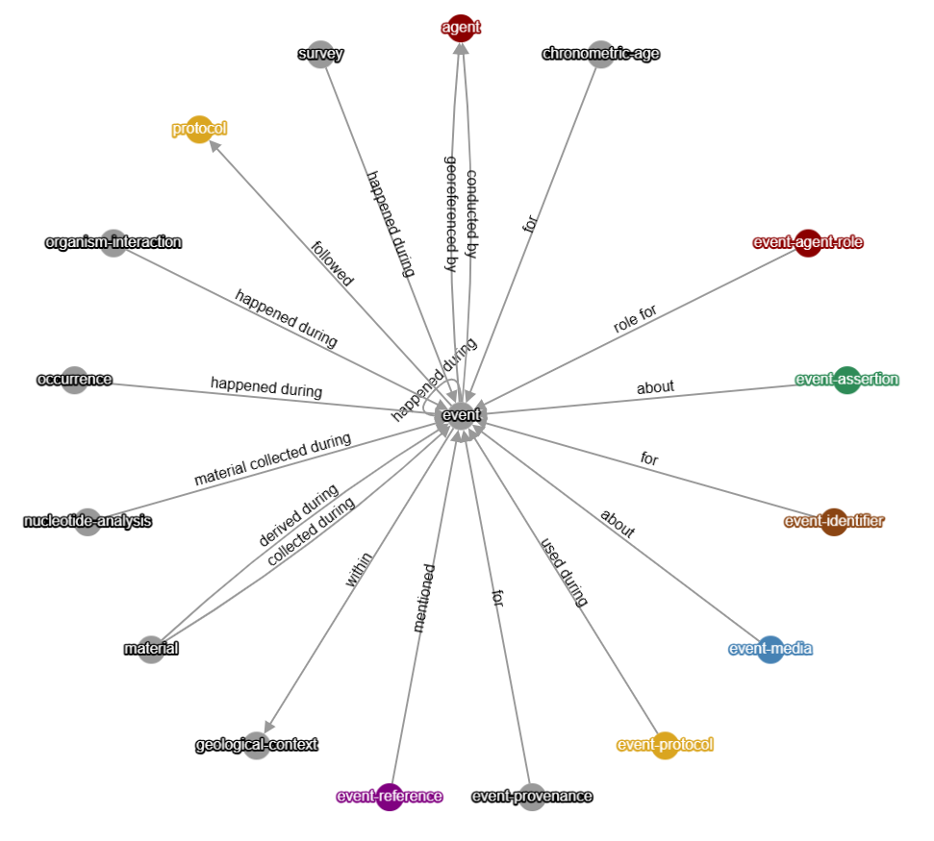
DwC-DP
treatment
applied to
Resource = Event

Slide 15
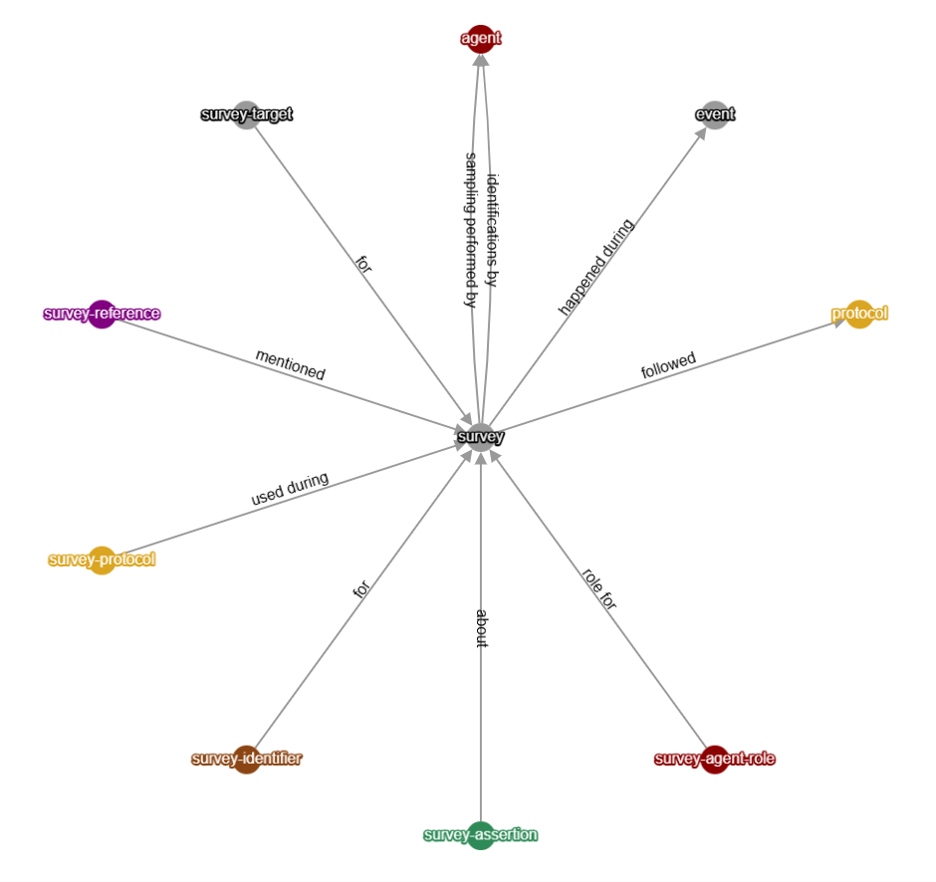
DwC-DP
Resource = Survey
applied to
treatment

Slide 16
What other resources might apply?

Slide 17
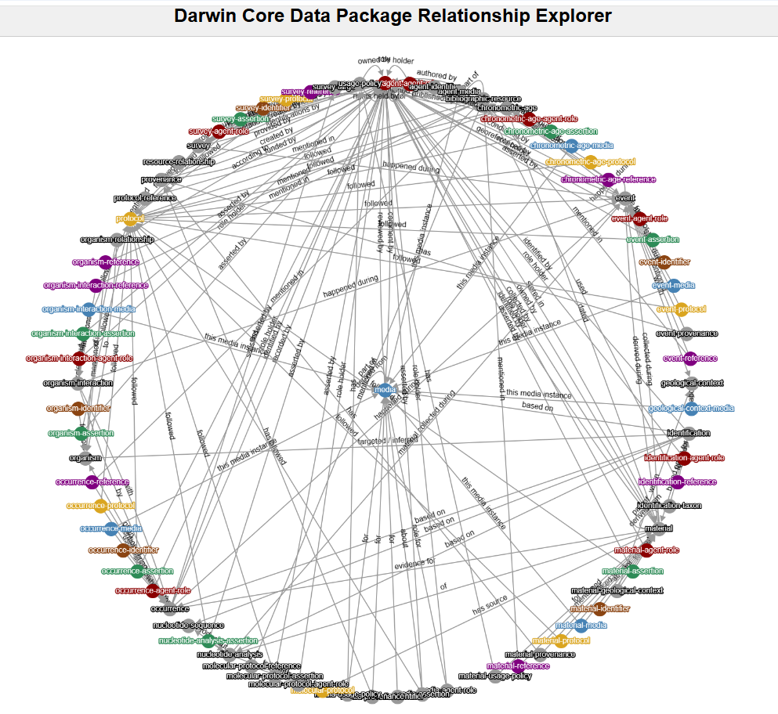
Other resources
Material
Media
Identification
OrganismInteraction
…

Slide 18
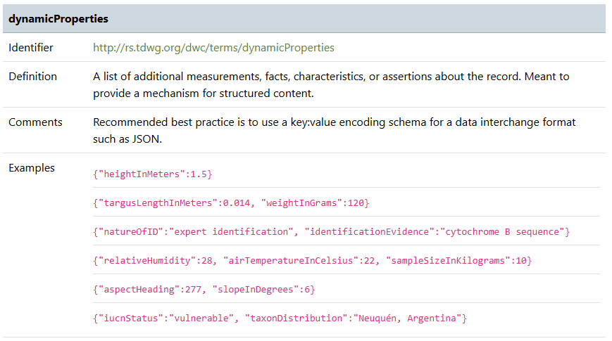
[
{
"treatmentID": "550e8400-e29b-41d4-a716-446655440000",
"originalResource": "s1234-occ1234",
"treatedResource": "s1234-occ1234t",
"resourceType": "dwc:Occurrence",
"treatmentType": "obfuscate coordinates",
"treatmentTarget": "dwc:decimalLatitude, dwc:decimalLongitude",
"treatmentReason": "Potential harm to people or property",
"treatmentDescription": "Coordinates obfuscated to bottom left corner of map grid square",
"treatmentStartDate": "24/09/2025",
"treatmentEndDate": "",
"treatmentOrganization": "Department Of Environment"
}
]
DwC implementation
dwc:Occurrence hasTreatment
~dynamicProperties

Slide 19
Are we using appropriate nomenclature?

Slide 20
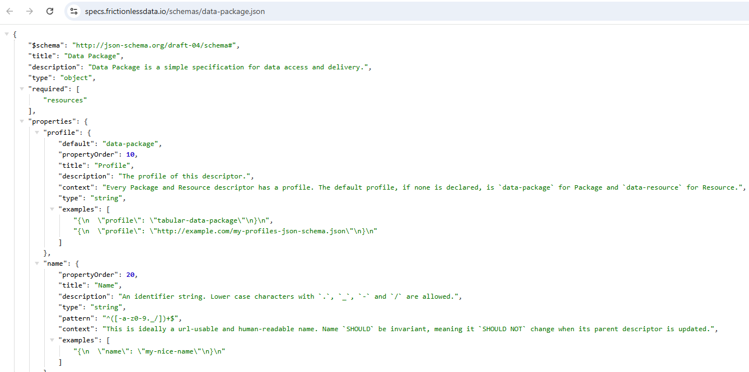
Things to think about
https://specs.frictionlessdata.io/schemas/data-package.json
How to to apply “Dataset” restrictions?
Part of the Data Package
How will the concept of “Records” be translated to DwC/DwC-DP?
Replace with “Resource”?

Slide 21
Thank you.
Gaia Resources
+61 8 9227 7309
Level 6, FLUX 191 St Georges Terrace, Perth
enquiries@gaiaresources.com.au

